Slide 1
Challenges and Opportunities in Flipped Writing Classrooms
A Preliminary Report

Slide 2
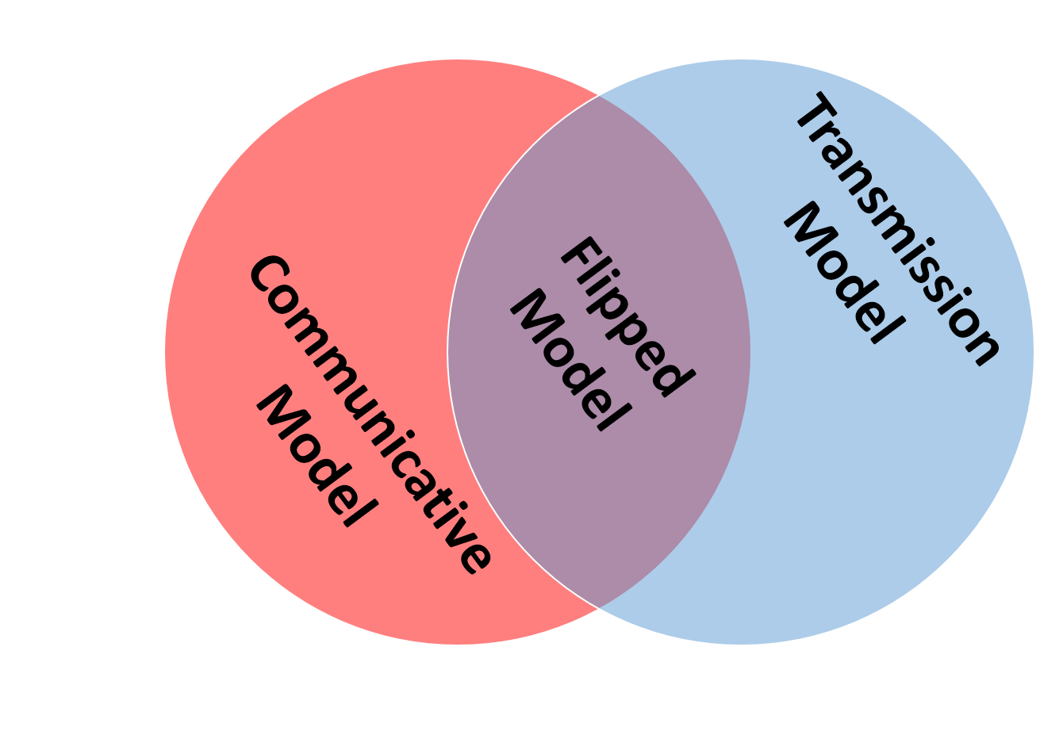
The Time Is Right to Flip
Educational culture, methods, and technology are intersecting to drive interest in what has come to be called the “Flipped Classroom”.
Theory and practice collide: Many in the field are promoting more communicative and networked approaches to learning. However, expectations are still largely transmission oriented.
Flipped learning addresses both of these concerns.
Notes:
Educational culture, methods, and technology are intersecting to drive interest in what has come to be called the “Flipped Classroom”.
Theory and practice collide: Many in the field of language education are promoting more communicative and networked approaches to learning. However, expectations are still largely transmission oriented.
Flipped learning addresses both of these concerns.
I view this largely as a compromise that can work to change classroom practice and maybe even change the public perception of knowledge and how we learn.

Slide 3
What is the Flipped Classroom?
Difference from previous methods utilizing front-loading of content
Promotion of digital technology to
create,
deliver,
consume, and
assess understanding of
content outside of class.
This makes flipped teaching a truly 21st Century approach.
Notes:
Difference from previous front-loading of content
What differentiates flipped teaching is the promotion of technology to create, deliver, consume, and assess understanding of content outside of class. This makes flipped teaching a truly 21st Century approach.

Slide 4
What is the Flipped Classroom?
Modern development of the idea
Walvoord & Anderson (1998)
General idea
Lage, Platt, & Treglia (2000)
“Inverting” the classroom
Baker (2000)
The “classroom flip”
Kahn (2006)
Kahn Academy
Bergman & Sams (2007)
Modelled (and evangelized) the flipped classroom with their high school science students in Colorado.
Notes:
Walvoord & Anderson (1998) – Promoted a similar approach that included the use of technology to “gain first-exposure” learning outside of class and then used the classroom to focus on higher-order thinking skills (Bloom: application, analysis, synthesis, and evaluation)
Lage, Platt, & Treglia (2000) – Termed it “Inverting” the classroom. Focused on addressing learning styles. Addressed the fact that this approach could be a compromise for constraints imposed by some teachers by institutions (society).
Baker (2000) – Termed it the “classroom flip”. Focused on helping teachers "become the guide on the side" instead of the "sage on the stage.“ Really emphasized the role of technology, particularly CMS/LMS for managing “homework”, to free time for active learning activities and collaboration.
Sal Kahn (2006) – His role is less theoretical, but more practical. His YouTube collection of simple, short, focused math tutorials eventually became the foundation for the Kahn Academy. His example was widely discussed in both teaching and research circles. His videos were criticized for propagating the transmission model of instruction, yet many saw this as one way to provide the lectures that so many expected while freeing class time for students to engage the content.
Bergman & Sams (2007) modelled (and evangelized) the flipped classroom with their high school science students in Colorado. They are probably the most frequently used examples in blogs and teaching magazines (practice-oriented discussions). They later published a book to further promote their model and experiences (Sams & Bergman, 2012).

Slide 5
What is the Flipped Classroom?
Lecture-type content
Recordings (audio/video), Interactive content, Interpersonal communication…
Assessment (motivation)
Assessment to gauge understanding of the content.
Motivation to view/participate in the content delivery
Classroom Q&A
Mini-Lectures / Just-in-time learning
Engagement with the content in ways that foster higher-order processing

Slide 6
The Context of this Study
Participants
67 3rd and 4th year English Education majors taking a required English writing course at a midsized, urban Korean university.
47 completed the course
20 completed survey
Class Description
Test writing (중등학교교사임용후보자선정경쟁시험)
Dual-focus on writing (lectures) and content (discussion)
Lectures on planning, editing, formatting, grammar, and other aspects of language usage (see video topics)
Process Writing
Four assignments focusing on SLA and Teaching Methods

Slide 7
Why Did I Do It?
Torn between student/institution expectations and personal theory of learning
Frustrated with a perceived lack of time to “cover everything”
Large amount of material
Roughly 2 usable class hrs/wk
Desire to focus on student engagement with the content during class time.
Need to increase higher-order processing of both writing and SLA/pedagogical concepts

Slide 8
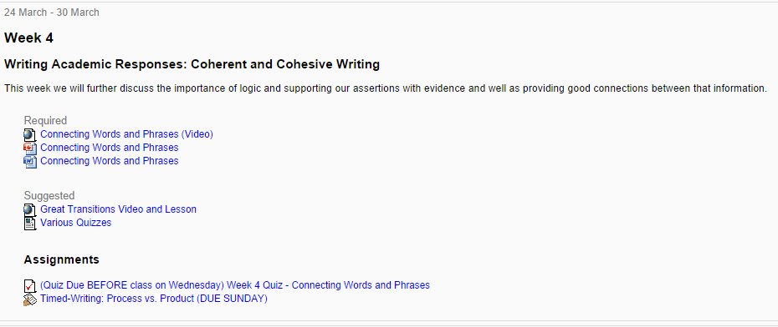
Design & Implementation LMS
LMS
Moodle
Notes:
I designed the courses much like Baker (2000) suggested and Bergman & Sams (2012) did.
LMS to organize
Video lectures
Assessment: quizzes, writing samples, and classroom performance
Classroom activities that encourage higher-order processing of the content

Slide 9
Design & Implementation Video
Video Requirements
Screencasting
Free to use
High-quality recordings
Narrated PowerPoints
Able to stream online
Variety of features
Video considerations
Mobile-ready
Editable
Flexible recording environment
Ease of use
Time limits
Number of free productions/storage/streams
Webcam functionality
Notes:
Movenote (): Side by side – Mobile (creation and viewing)
ActivePresenter + YouTube (): PPT only - Mobile
Knov.io (): Side by side - No mobile viewing option
Present.me (): Side by side – mobile ready

Slide 10
Videos ActivePresenter
ActivePresenter + YouTube
Processing Writing

Slide 11
Videos MoveNote
MoveNote
Test Writing

Slide 12
Videos Present.me
Present.me
Logical Connections
Descriptive Writing
Articles & Commas

Slide 13
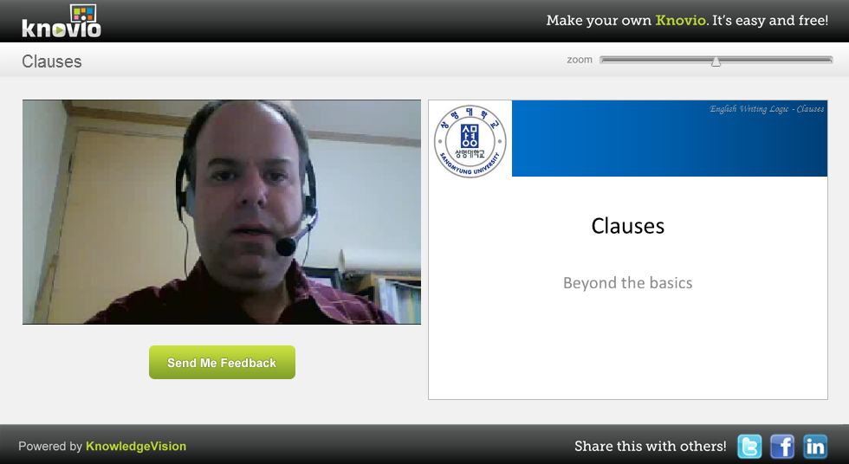
Videos knovio
knovio
Connecting Words and Phrases
Clauses

Slide 14
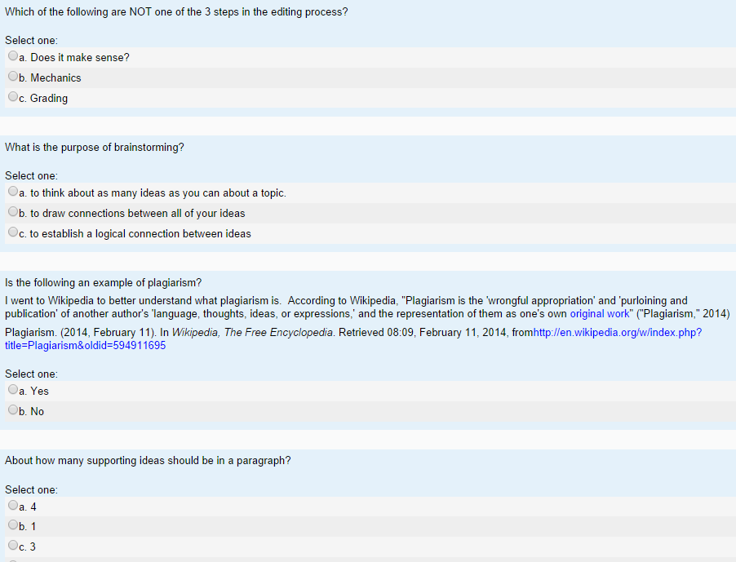
Design & Implementation Assessment
Quizzes
Writing Samples
Class performance

Slide 15
Design & Implementation Activities
Questions & Answers
Mini-lectures
Group Discussions (writing, SLA, and teaching)
Focused activities (micro-writing and worksheets)
Brainstorming
Outlining
Timed-writing
Peer editing
One-on-one/small group editing and consultations

Slide 16
Data Collection & Analysis
General
Documents
LMS
Students
Surveys
Observations
Class Q&A
Writing Samples
Teacher
Journals/Notes
Design Changes

Slide 17
Student Perceptions Video
Liked the video lectures
However, not all. “I think in class lectures are better than video lectures.”
Thought the quality of the online lectures weren’t as good.
Preferred videos with professor’s webcam
19 of 20 surveyed
Video service preferences
MoveNote 10/20
Present.me 10/20
ActivePresenter + YouTube 2/20
knovio 1/20
Preferred shorter to longer videos
Shorter than 15 minutes
Approved of course video length (2.35, n=20)
Preferred mobile-ready
Only 1 of 20 surveyed preferred the video without a mobile option
“If we can watch the video lecture on mobile phone, we need not find computers.“
Notes:
Students indicated that they liked the videos and, in fact, wished that more would be provided. They preferred videos that had both PowerPoint slides and the professor’s talking head (webcam) to those that had slides only. Not surprisingly, they generally preferred shorter videos to longer videos. Some students expressed frustration if they could not view the videos on their mobile devices (knovio was not mobile ready). They disliked the quizzes and felt that they should not have had to take them prior to discussing the topics in class. They appreciated the time spent writing and discussing topics in class as it both helped them to better understand the concepts and it reduced the time necessary outside of class to write their essays.
“…classroom activities such as brainstorming, peer-editing, and discussion are very helpful to students to make their own ideas and develop writing skill.”
“Classroom activities were really good. I could talk and share some ideas with various people, which was so good. “
“I liked the natural conversation or discussion between others during the activities. I think activities help speaking and also they motivate learning. “
“I think that the way of the this semester's class was very good and efficient’
“The classroom activities were fun and beneficial to me. Because of the video lecture, I could understand and do more easily. I liked the classroom activities. “
Quizzes
Concerns were over: forgetting to do them, not a good method of grading/assessment in the way given
Some like/appreciated them
Improve Videos
“If we can watch the video lecture on mobile phone, we need not find computers. “
“I think in class lectures are better than video lectures. For me, it is more confused to understand the meaning from the video lectures. But if you want to use video, then I would recommend you to use more visual slides so that we can easily understand. Slides with bunch of texts are NOT good. It is very difficult to read and listen at the same time. And how about giving us some examples? I mean, sample writings about the lecture. It helps me understand clearly. “
“It was my first time to have video lectures. I am really satisfied with this video lectures. I could watch whenever I want to see and study. This way of class was very good. “
Video Time:
less than 10 - 4/20; 10 min 7/20; 15-30 - 7/20; more than 30 - 2/20
Video app
Present.me 7 YouTube 2 MoveNote 10 knovio 1

Slide 18
Student Perceptions Quizzes & Activities
Disliked quizzes
Forgetting to do them
Not a good way to “grade”
Liked class activities
“…classroom activities such as brainstorming, peer-editing, and discussion are very helpful to students to make their own ideas and develop writing skill.”
Notes:
Students indicated that they liked the videos and, in fact, wished that more would be provided. They preferred videos that had both PowerPoint slides and the professor’s talking head (webcam) to those that had slides only. Not surprisingly, they generally preferred shorter videos to longer videos. Some students expressed frustration if they could not view the videos on their mobile devices (knovio was not mobile ready). They disliked the quizzes and felt that they should not have had to take them prior to discussing the topics in class. They appreciated the time spent writing and discussing topics in class as it both helped them to better understand the concepts and it reduced the time necessary outside of class to write their essays.
“…classroom activities such as brainstorming, peer-editing, and discussion are very helpful to students to make their own ideas and develop writing skill.”
“Classroom activities were really good. I could talk and share some ideas with various people, which was so good. “
“I liked the natural conversation or discussion between others during the activities. I think activities help speaking and also they motivate learning. “
“I think that the way of the this semester's class was very good and efficient’
“The classroom activities were fun and beneficial to me. Because of the video lecture, I could understand and do more easily. I liked the classroom activities. “
Quizzes
Concerns were over: forgetting to do them, not a good method of grading/assessment in the way given
Some like/appreciated them
Improve Videos
“If we can watch the video lecture on mobile phone, we need not find computers. “
“I think in class lectures are better than video lectures. For me, it is more confused to understand the meaning from the video lectures. But if you want to use video, then I would recommend you to use more visual slides so that we can easily understand. Slides with bunch of texts are NOT good. It is very difficult to read and listen at the same time. And how about giving us some examples? I mean, sample writings about the lecture. It helps me understand clearly. “
“It was my first time to have video lectures. I am really satisfied with this video lectures. I could watch whenever I want to see and study. This way of class was very good. “
Video Time:
less than 10 - 4/20; 10 min 7/20; 15-30 - 7/20; more than 30 - 2/20
Video app
Present.me 7 YouTube 2 MoveNote 10 knovio 1

Slide 19
Student Perceptions Preparing for Class
I use a textbook to prepare for class.
4 vs. 9 (7 Occasionally)
I use a website to prepare for class.
2 vs. 14 (4 Occasionally)
I use audio recordings to prepare for class.
11 vs. 4 (5 Occasionally)
I use videos to prepare for class.
10 vs. 2 (8 Occasionally)
I use smartphone apps to prepare for class.
3 vs. 7 (8 Occasionally)
Notes:
I use a textbook to prepare for class. 4 vs. 9 (7 Occasionally)
I use a website to prepare for class. 2 vs. 14 (4 Occasionally)
I use audio recordings to prepare for class. 11 vs. 4 (5 Occasionally)
I use videos to prepare for class. 10 vs. 2 (8 Occasionally)
I use smartphone apps to prepare for class. 3 vs. 7 (8 Occasionally)
I think that using video lectures is a good method of instruction. 3.95
I liked the video lectures that we watched. 3.85
I believe that it is important for teachers to lecture in class. 4.3
I believe it is important to check whether students do the required homework for the course (reading, worksheets, videos, etc.). 4.1
I think that the online quizzes we did this semester were a good way to check if students watched the video lectures. 3.65
I believe that class time is best used to do activities that help students learn the course content deeply. 4.05
I think that the activities we did in class helped me learn the course content deeply. 4
I watched each of the video lectures. 3.75
I completed each of the online quizzes last semester. 3.6
I participated to the best of my ability in class last semester. 3.45

Slide 20
Student Perceptions Lectures & Accountability
I think that using video lectures is a good method of instruction. 3.95
I liked the video lectures that we watched. 3.85
I believe that it is important for teachers to lecture in class. 4.3
I believe it is important to check whether students do the required homework for the course (reading, worksheets, videos, etc.). 4.1
I think that the online quizzes we did this semester were a good way to check if students watched the video lectures. 3.65
Notes:
I use a textbook to prepare for class. 4 vs. 9 (7 Occasionally)
I use a website to prepare for class. 2 vs. 14 (4 Occasionally)
I use audio recordings to prepare for class. 11 vs. 4 (5 Occasionally)
I use videos to prepare for class. 10 vs. 2 (8 Occasionally)
I use smartphone apps to prepare for class. 3 vs. 7 (8 Occasionally)
I think that using video lectures is a good method of instruction. 3.95
I liked the video lectures that we watched. 3.85
I believe that it is important for teachers to lecture in class. 4.3
I believe it is important to check whether students do the required homework for the course (reading, worksheets, videos, etc.). 4.1
I think that the online quizzes we did this semester were a good way to check if students watched the video lectures. 3.65
I believe that class time is best used to do activities that help students learn the course content deeply. 4.05
I think that the activities we did in class helped me learn the course content deeply. 4
I watched each of the video lectures. 3.75
I completed each of the online quizzes last semester. 3.6
I participated to the best of my ability in class last semester. 3.45

Slide 21
Student Perceptions
I believe that class time is best used to do activities that help students learn the course content deeply. 4.05
I think that the activities we did in class helped me learn the course content deeply. 4
I watched each of the video lectures. 3.75
I completed each of the online quizzes last semester. 3.6
Notes:
I use a textbook to prepare for class. 4 vs. 9 (7 Occasionally)
I use a website to prepare for class. 2 vs. 14 (4 Occasionally)
I use audio recordings to prepare for class. 11 vs. 4 (5 Occasionally)
I use videos to prepare for class. 10 vs. 2 (8 Occasionally)
I use smartphone apps to prepare for class. 3 vs. 7 (8 Occasionally)
I think that using video lectures is a good method of instruction. 3.95
I liked the video lectures that we watched. 3.85
I believe that it is important for teachers to lecture in class. 4.3
I believe it is important to check whether students do the required homework for the course (reading, worksheets, videos, etc.). 4.1
I think that the online quizzes we did this semester were a good way to check if students watched the video lectures. 3.65
I believe that class time is best used to do activities that help students learn the course content deeply. 4.05
I think that the activities we did in class helped me learn the course content deeply. 4
I watched each of the video lectures. 3.75
I completed each of the online quizzes last semester. 3.6
I participated to the best of my ability in class last semester. 3.45

Slide 22
Teacher Perceptions
Video
Concerned more with ease of use and functionality
Liked Present.me the best
Easy to learn, recorded both PPT and webcam, excellent quality video, and mobile ready
Quizzes
Disappointed with the quizzes
Low performance
Unused by many (over 30% not attempted)
Seemed to be the Ss who were no well-prepared in class
In-class Activities
Generally satisfied by the increased time available to address students’ needs individually
Sometimes, I felt that I was under-prepared or didn’t have appropriately engaging activities.
Notes:
As the professor/researcher, I had a different perspective. My concern with the videos was in the ease of use and functionality that the programs provided. Of the four, Present.me was clearly the best for my purposes. The program was easy to learn, it recorded both PowerPoint slides and my webcam video, the quality of the video was excellent, and it was mobile ready.
I was perplexed and disappointed with the students’ performance on the quizzes. I designed the quizzes to be simple in that they were based on information in the video and most questions could have been answered with information from the PowerPoints. The scores for those who attempted the quizzes were not problematic, but over 30% of the quizzes were not attempted. When asked, students indicated that they either forgot to do it, did not have time to do it, or did not know that they had to do it. From our interactions in class, I noted that these were often the students who seemed less prepared, less knowledgeable of the video content.
I was satisfied with the classroom activities. By moving much of the lecturing to video, the classes had much more time to engage in writing-related activities and I was able to have more one-on-one time with students who were struggling. This is something I would not have had time for if I had to lecture. Since we did have more time to do activities during class, I sometimes found that I was under-prepared or that I did not have adequate activities for the content focus.

Slide 23
Suggested Design Changes
Videos
Alternative Software
Shorten videos
Provide more examples
Demonstrate
Quizzes
Reminders
Integrate videos and quizzes
Activities
Demonstrate writing and editing more
Provide and practice daily objectives
Notes:
Based on student and teacher experiences, the there are a number of instructional design changes that will take place in future classes.
Videos will be shorter. This will be accomplished by making more videos that focus on fewer elements in each.
I still think that quick quizzes are a good way to encourage students to watch the video lectures and to assess their understanding of the content prior to coming to class. It is clear, however, I must find a better way to push students to both view the videos and take the quizzes.
Lastly, more/better activities need to be developed for classes. In particular, I found that we had too few writing samples, too few opportunities to correct negative examples, and too few opportunities to write for the instructional objectives of the day.

Slide 24
Questions?
Dan Craig
@seouldaddy
dan@danielcraig.com
http://www.danielcraig.com

