Slide 1
Korean Flipped Writing Classes
Learning from Doing
Daniel Craig
Sangmyung University, Seoul
dan@danielcraig.com

Slide 2
Overview
Flipped Classrooms: Impetus and Definitions
Goals of the Study
Methods: Context and Measures
Results: Surveys and Interviews
Discussion: Reactions to a Flipped Classroom
Conclusion: Considerations for Future Iterations

Slide 3
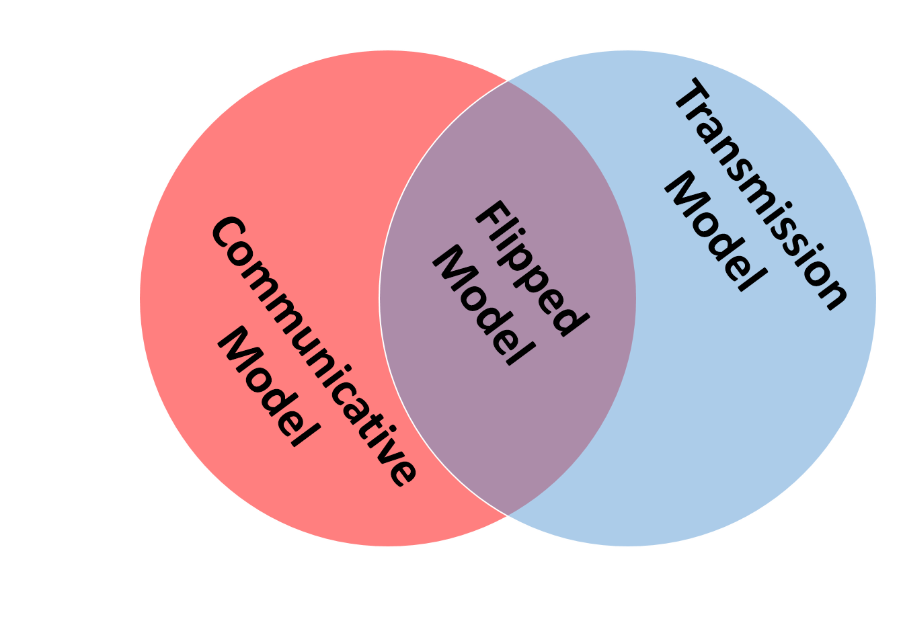
Flipped Classrooms: Impetus for Change
Educational culture, methods, and technology are intersecting to drive interest in what has come to be called the “Flipped Classroom”.
Theory and practice collide: Many in the field are promoting more communicative and networked approaches to learning. However, expectations are still largely transmission oriented.
Flipped learning addresses both of these concerns.
Notes:
Educational culture, methods, and technology are intersecting to drive interest in what has come to be called the “Flipped Classroom”.
Theory and practice collide: Many in the field of language education are promoting more communicative and networked approaches to learning. However, expectations are still largely transmission oriented.
Flipped learning addresses both of these concerns.
I view this largely as a compromise that can work to change classroom practice and maybe even change the public perception of knowledge and how we learn.

Slide 4
Flipped Classrooms: Definitions (1)
Difference from previous methods utilizing front-loading of content
Promotion of digital technology to
create,
deliver,
consume, and
assess understanding of content outside of class.
Notes:
Difference from previous front-loading of content
What differentiates flipped teaching is the promotion of technology to create, deliver, consume, and assess understanding of content outside of class. This makes flipped teaching a truly 21st Century approach.

Slide 5
Flipped Classrooms: Definitions (2)
Modern development of the idea
Walvoord & Anderson (1998)
General idea
Lage, Platt, & Treglia (2000)
“Inverting” the classroom
Baker (2000)
The “classroom flip”
Kahn (2006)
Kahn Academy
Bergman & Sams (2007)
Modelled (and evangelized) the flipped classroom with their high school science students in Colorado.
Notes:
Walvoord & Anderson (1998) – Promoted a similar approach that included the use of technology to “gain first-exposure” learning outside of class and then used the classroom to focus on higher-order thinking skills (Bloom: application, analysis, synthesis, and evaluation)
Lage, Platt, & Treglia (2000) – Termed it “Inverting” the classroom. Focused on addressing learning styles. Addressed the fact that this approach could be a compromise for constraints imposed by some teachers by institutions (society).
Baker (2000) – Termed it the “classroom flip”. Focused on helping teachers "become the guide on the side" instead of the "sage on the stage.“ Really emphasized the role of technology, particularly CMS/LMS for managing “homework”, to free time for active learning activities and collaboration.
Sal Kahn (2006) – His role is less theoretical, but more practical. His YouTube collection of simple, short, focused math tutorials eventually became the foundation for the Kahn Academy. His example was widely discussed in both teaching and research circles. His videos were criticized for propagating the transmission model of instruction, yet many saw this as one way to provide the lectures that so many expected while freeing class time for students to engage the content.
Bergman & Sams (2007) modelled (and evangelized) the flipped classroom with their high school science students in Colorado. They are probably the most frequently used examples in blogs and teaching magazines (practice-oriented discussions). They later published a book to further promote their model and experiences (Sams & Bergman, 2012).
Focus on interaction and experience over transmission (Vygotsky, 1978; Piaget, 1957)
Students have liked flipped implementations (Bergman & Sams, 2012; Foertsch, et al, 2002; Strayer, 2007; Kim, Byun, & Lee, 2012; Lage, Platt, & Treglia, 2000; Mazur, 1991)
Some students struggled as the flipped class required a change in their process (Foertsch, et al, 2002; Lage, Platt, and Treglia, 2000; Strayer, 2007)
Self-efficacy (Bandura, 1997)
Those using video lectures outperform f2f (Cohen, Ebeling, & Kulik, 1981; Zhang, Zhou, Briggs, & Nunamaker, 2006; McNeil, 1989)
Those who watched videos came to class more prepared (DeGrazia, Falconer, Nicodemus, and Medlin, 2012)
Students preferred f2f lectures to video, but also preferred interactive classes over f2f lectures (Toto & Nguyen, 2009)
Shorter videos are preferred (Zappe, Lieicht, Messner, Litzinger, & Lee, 2009)
Positive reports of Korean implementation in Busan (Horn, 2014)
Increase in engagement and achievement (McGiveny-Burelle & Xue, 2013; Love, Hodge, Grandgenett, & Swift, 2013)
Bloom’s Taxonomy (Bloom, ; Krathwohl, 2002)
Mobile phone penetration at 83% in Korea (Yonhap News, 2015)

Slide 6
Flipped Classrooms: Definitions (3)
Lecture-type content (pre-loading)
Recordings (audio/video), Interactive content, Interpersonal communication…
Assessment (motivation)
Assessment to gauge understanding of the content.
Motivation to view/participate in the content delivery
Classroom Q&A
Mini-Lectures / Just-in-time learning
Engagement with the content in ways that foster higher-order processing

Slide 7
Goals of the Study
A better understanding of how learners perceive, perform in, and engage with a flipped classroom implementation in an academic writing class at a Korean university.
Research Questions
Is there any correlation between self-efficacy and measures of performance or satisfaction?
Is there any correlation between foreign language learning anxiety and measures of performance or satisfaction?
Is there a relationship between learner perceptions of course design and performance?
How students feel about lecture videos, quizzes, and the overall use of a flipped model in the writing course?

Slide 8
Methods: Context
Location
Mid-sized urban university in Korea
Participants
46 (16 male, 30 female) English Education majors agreed to participate in the study (survey & document analysis).
2nd year (1), 3rd year (32), 4th year (13)
13 participated in interviews
Notes:
Korean Teachers Exam – 중등학교 교사신규 임용후보자선정경쟁시험

Slide 9
Methods: Context
Course
Topic: Academic writing course focused specifically on writing for the Korean Teachers’ Exam
Video Lecture Topics (8): test writing response forms, process writing and self-/peer-editing, paragraphs, connecting words and phrases, logical connections and argumentation, descriptive writing, article and comma usage, and clauses
Quizzes (5): as grouped above. The clauses topic did not have an associated quiz.
Writing: 2 formal ungraded (pass-fail) writing assignments (diagnostic and introduction); 4 formal graded writing assignments (Process vs. Product approach to writing instruction; Communicative Competence; Fossilization; and Communicative Language Teaching)
Notes:
Korean Teachers Exam – 중등학교 교사신규 임용후보자선정경쟁시험

Slide 10
Methods: Design of the Course
LMS to organize course content
Moodle (http://www.danielcraig.com/smuenglish/course/view.php?id=20)
Video lectures to pre-load course content
Total of 8 videos throughout the semester
Frontloaded into the first 2/3 of the semester
Online quizzes to assess consumption of course content
Total of 5 quizzes used with 8 videos
Q&A and the review of key concepts at the beginning of class
Increased focus on activities promoting higher-order thinking skills during class.
Group Discussions (writing, SLA, and teaching), Focused activities (micro-writing and worksheets), Brainstorming, Outlining, Timed-writing, Peer editing, One-on-one/small group editing and consultations
Notes:
I designed the courses much like Baker (2000) suggested and Bergman & Sams (2012) did.
LMS to organize
Video lectures
Assessment: quizzes, writing samples, and classroom performance
Classroom activities that encourage higher-order processing of the content

Slide 11
Methods: Data Collection & Analysis
End-of-course survey
General Self-Efficacy Scale (GSE) (Schwarzer & Jerusalem,1995)
Cronbach’s Alpha; Pearson Correlations
Foreign Language Classroom Anxiety Scale (FLCAS) (Horwitz, 1986, 2001)
Cronbach’s Alpha; Pearson Correlations
Preferences and Perceptions
Pearson Correlations
Course performance measures
Quiz grades, Writing grades, and Final grades
Pearson Correlations
Interviews
Semi-structured interviews
Coding of commentary on videos, quizzes, design, and flipped classroom
Notes:
The General Self-Efficacy Scale (GSE)
Schwarzer, R., & Jerusalem, M. (1995). Generalized Self-Efficacy scale. In J. Weinman, S. Wright, & M. Johnston, Measures in health psychology: A user’s portfolio. Causal and control beliefs (pp. 35-37). Windsor, UK: NFER-NELSON.
English - http://userpage.fu-berlin.de/~health/engscal.htm
Universal construct, including Korean - Luszczynska, A., Scholz, U., & Schwarzer, R. (2005). The general self-efficacy scale: Multicultural validation studies. The Journal of Psychology, 139(5), 439–457.
Foreign Language Classroom Anxiety Scale (FLCAS)
Horwitz, E. K., M. B. Horwitz, et al. (1986). "Foreign language classroom anxiety." The Modern Language Journal 70(2): 125-132.
Horwitz, E. K. (2001). "Language anxiety and achievement." Annual Review of Applied Linguistics 21: 112-126.
Course Performance Measures
Is there any relationship between survey measures and performance measures?
Interviews
Semi-structured based on survey responses.
Evolution of questions based on completed interviews (quiz integration, quiz motivation,

Slide 12
Results: GSE & Performance
 |  | GSE Total Score | Total Quiz grade | GradeWriting | GradeFinal
GSE Total Score | Pearson Correlation | 1 | .257 | .034 | .078
 | Sig. (2-tailed) |  | .085 | .824 | .605
 | N | 46 | 46 | 46 | 46
Total Quiz grade | Pearson Correlation | .257 | 1 | .553** | .641**
 | Sig. (2-tailed) | .085 |  | .000 | .000
 | N | 46 | 46 | 46 | 46
GradeWriting | Pearson Correlation | .034 | .553** | 1 | .984**
 | Sig. (2-tailed) | .824 | .000 |  | .000
 | N | 46 | 46 | 46 | 46
GradeFinal | Pearson Correlation | .078 | .641** | .984** | 1
 | Sig. (2-tailed) | .605 | .000 | .000
 | N | 46 | 46 | 46 | 46
**. Correlation is significant at the 0.01 level (2-tailed).
Notes:
High correlation: .5 to 1.0 or -0.5 to 1.0 Medium correlation: .3 to .5 or -0.3 to .5 Low correlation: .1 to .3 or -0.1 to -0.3
Cronbach’s alpha: 10 items; α=.76
Quiz grades showed a high positive correlation with writing grades. This is interesting because is no direct connection between the two. While it would be nice to think that watching the video lectures resulted in higher grades, this isn’t supported by the data that show no significant low correlation between reports of watching the video lectures and any measure of performance.
In this case, it just seems that participants who perform well on one task tend to perform well on anohter.

Slide 13
Results: GSE & Lectures
 |  | GSE Total Score | I believe that it is important for teachers to lecture in class. | I think that using video lectures is a good method of instruction. | I liked the video lectures that we watched. | I watched each of the video lectures.
GSE Total Score | Pearson Correlation | 1 | .018 | .175 | .074 | .079
 | Sig. (2-tailed) |  | .903 | .244 | .623 | .604
 | N | 46 | 46 | 46 | 46 | 46
I believe that it is important for teachers to lecture in class. | Pearson Correlation | .018 | 1 | .342* | .327* | .279
 | Sig. (2-tailed) | .903 |  | .020 | .027 | .061
 | N | 46 | 46 | 46 | 46 | 46
I think that using video lectures is a good method of instruction. | Pearson Correlation | .175 | .342* | 1 | .763** | .414**
 | Sig. (2-tailed) | .244 | .020 |  | .000 | .004
 | N | 46 | 46 | 46 | 46 | 46
I liked the video lectures that we watched. | Pearson Correlation | .074 | .327* | .763** | 1 | .510**
 | Sig. (2-tailed) | .623 | .027 | .000 |  | .000
 | N | 46 | 46 | 46 | 46 | 46
I watched each of the video lectures. | Pearson Correlation | .079 | .279 | .414** | .510** | 1
 | Sig. (2-tailed) | .604 | .061 | .004 | .000
 | N | 46 | 46 | 46 | 46 | 46
*. Correlation is significant at the 0.05 level (2-tailed).
**. Correlation is significant at the 0.01 level (2-tailed).
Notes:
It is good to note that there is a high positive correlation between thinking that video lectures are good methods of instruction and liking and watching the video lectures. In addition to a high positive correlation between liking and watching the videos.
The low-moderate correlations between belief in the importance of classroom lectures and beliefs in video lectures as a good instructional method and liking the video lectures in the class could indicate overall favorability toward lecturing. However, this is certainly not a strong correlation.

Slide 14
Results: GSE & Quizzes
 |  | GSE Total Score | I believe it is important to check whether students do the required homework for the course. | I think that the online quizzes we did last semester were a good way to check if students watched the video lectures. | I completed each of the online quizzes last semester.
GSE Total Score | Pearson Correlation | 1 | .261 | .142 | .147
 | Sig. (2-tailed) |  | .080 | .348 | .329
 | N | 46 | 46 | 46 | 46
I believe it is important to check whether students do the required homework for the course. | Pearson Correlation | .261 | 1 | .514** | .306*
 | Sig. (2-tailed) | .080 |  | .000 | .039
 | N | 46 | 46 | 46 | 46
I think that the online quizzes we did last semester were a good way to check if students watched the video lectures. | Pearson Correlation | .142 | .514** | 1 | .505**
 | Sig. (2-tailed) | .348 | .000 |  | .000
 | N | 46 | 46 | 46 | 46
I completed each of the online quizzes last semester. | Pearson Correlation | .147 | .306* | .505** | 1
 | Sig. (2-tailed) | .329 | .039 | .000
 | N | 46 | 46 | 46 | 46
**. Correlation is significant at the 0.01 level (2-tailed).
*. Correlation is significant at the 0.05 level (2-tailed).
Notes:
High positive correlation between those who thought that it is important to check whether students did the homework and that the quizzes were good for this purpose as well as a high positive correlation between thinking that the online quizzes were a good way to check if students watched the video and reported completion of the quizzes. Those who think it is good and effective are more likely to complete/participate in the system.

Slide 15
Results: GSE & Class Time
 |  | GSE Total Score | I believe that class time is best used to do activities that help students learn the course content deeply. | I think that the activities we did in class helped me learn the course content deeply. | I participated to the best of my ability in class last semester.
GSE Total Score | Pearson Correlation | 1 | .100 | .017 | .223
 | Sig. (2-tailed) |  | .507 | .911 | .136
 | N | 46 | 46 | 46 | 46
I believe that class time is best used to do activities that help students learn the course content deeply. | Pearson Correlation | .100 | 1 | .494** | .416**
 | Sig. (2-tailed) | .507 |  | .000 | .004
 | N | 46 | 46 | 46 | 46
I think that the activities we did in class helped me learn the course content deeply. | Pearson Correlation | .017 | .494** | 1 | .539**
 | Sig. (2-tailed) | .911 | .000 |  | .000
 | N | 46 | 46 | 46 | 46
I participated to the best of my ability in class last semester. | Pearson Correlation | .223 | .416** | .539** | 1
 | Sig. (2-tailed) | .136 | .004 | .000
 | N | 46 | 46 | 46 | 46
**. Correlation is significant at the 0.01 level (2-tailed).
Notes:
I seems that those who found value in the course activities tended to participate to the best of their ability.

Slide 16
Results: GSE & Materials Availability
 |  | GSE Total Score | It is important that class materials are available online | It is important that class materials are available on my mobile device.
GSE Total Score | Pearson Correlation | 1 | .037 | .195
 | Sig. (2-tailed) |  | .807 | .193
 | N | 46 | 46 | 46
It is important that class materials are available online | Pearson Correlation | .037 | 1 | .474**
 | Sig. (2-tailed) | .807 |  | .001
 | N | 46 | 46 | 46
It is important that class materials are available on my mobile device. | Pearson Correlation | .195 | .474** | 1
 | Sig. (2-tailed) | .193 | .001
 | N | 46 | 46 | 46
**. Correlation is significant at the 0.01 level (2-tailed).
Notes:
There is a moderate correlation between those favoring online materials and mobile-ready materials. I was a little surprised. I thought that would have been a clearer relationship.

Slide 17
Results: FLCAS & Performance
 |  | FLCAS Total Score | Total Quiz grade | GradeWriting | GradeFinal
FLCAS Total Score | Pearson Correlation | 1 | -.166 | -.161 | -.183
 | Sig. (2-tailed) |  | .270 | .286 | .223
 | N | 46 | 46 | 46 | 46
Total Quiz grade | Pearson Correlation | -.166 | 1 | .553** | .641**
 | Sig. (2-tailed) | .270 |  | .000 | .000
 | N | 46 | 46 | 46 | 46
GradeWriting | Pearson Correlation | -.161 | .553** | 1 | .984**
 | Sig. (2-tailed) | .286 | .000 |  | .000
 | N | 46 | 46 | 46 | 46
GradeFinal | Pearson Correlation | -.183 | .641** | .984** | 1
 | Sig. (2-tailed) | .223 | .000 | .000
 | N | 46 | 46 | 46 | 46
**. Correlation is significant at the 0.01 level (2-tailed).
Notes:
Cronbach’s alpha: 10 items; α=.91

Slide 18
Results: FLCAS & Lectures
 |  | FLCAS Total Score | I believe that it is important for teachers to lecture in class. | I think that using video lectures is a good method of instruction. | I liked the video lectures that we watched. | I watched each of the video lectures.
FLCAS Total Score | Pearson Correlation | 1 | .412** | .215 | .099 | .002
 | Sig. (2-tailed) |  | .004 | .151 | .513 | .991
 | N | 46 | 46 | 46 | 46 | 46
I believe that it is important for teachers to lecture in class. | Pearson Correlation | .412** | 1 | .342* | .327* | .279
 | Sig. (2-tailed) | .004 |  | .020 | .027 | .061
 | N | 46 | 46 | 46 | 46 | 46
I think that using video lectures is a good method of instruction. | Pearson Correlation | .215 | .342* | 1 | .763** | .414**
 | Sig. (2-tailed) | .151 | .020 |  | .000 | .004
 | N | 46 | 46 | 46 | 46 | 46
I liked the video lectures that we watched. | Pearson Correlation | .099 | .327* | .763** | 1 | .510**
 | Sig. (2-tailed) | .513 | .027 | .000 |  | .000
 | N | 46 | 46 | 46 | 46 | 46
I watched each of the video lectures. | Pearson Correlation | .002 | .279 | .414** | .510** | 1
 | Sig. (2-tailed) | .991 | .061 | .004 | .000
 | N | 46 | 46 | 46 | 46 | 46
**. Correlation is significant at the 0.01 level (2-tailed).
*. Correlation is significant at the 0.05 level (2-tailed).
Notes:
Why? Those with high anxiety prefer to listen over participate??

Slide 19
Results: FLCAS & Quizzes
 |  | FLCAS Total Score | I believe it is important to check whether students do the required homework for the course. | I think that the online quizzes we did last semester were a good way to check if students watched the video lectures. | I completed each of the online quizzes last semester.
FLCAS Total Score | Pearson Correlation | 1 | -.009 | .045 | -.123
 | Sig. (2-tailed) |  | .951 | .764 | .416
 | N | 46 | 46 | 46 | 46
I believe it is important to check whether students do the required homework for the course. | Pearson Correlation | -.009 | 1 | .514** | .306*
 | Sig. (2-tailed) | .951 |  | .000 | .039
 | N | 46 | 46 | 46 | 46
I think that the online quizzes we did last semester were a good way to check if students watched the video lectures. | Pearson Correlation | .045 | .514** | 1 | .505**
 | Sig. (2-tailed) | .764 | .000 |  | .000
 | N | 46 | 46 | 46 | 46
I completed each of the online quizzes last semester. | Pearson Correlation | -.123 | .306* | .505** | 1
 | Sig. (2-tailed) | .416 | .039 | .000
 | N | 46 | 46 | 46 | 46
**. Correlation is significant at the 0.01 level (2-tailed).
*. Correlation is significant at the 0.05 level (2-tailed).

Slide 20
Results: FLCAS & Class Time
 |  | FLCAS Total Score | I believe that class time is best used to do activities that help students learn the course content deeply. | I think that the activities we did in class helped me learn the course content deeply. | I participated to the best of my ability in class last semester.
FLCAS Total Score | Pearson Correlation | 1 | .075 | .037 | .052
 | Sig. (2-tailed) |  | .619 | .805 | .734
 | N | 46 | 46 | 46 | 46
I believe that class time is best used to do activities that help students learn the course content deeply. | Pearson Correlation | .075 | 1 | .494** | .416**
 | Sig. (2-tailed) | .619 |  | .000 | .004
 | N | 46 | 46 | 46 | 46
I think that the activities we did in class helped me learn the course content deeply. | Pearson Correlation | .037 | .494** | 1 | .539**
 | Sig. (2-tailed) | .805 | .000 |  | .000
 | N | 46 | 46 | 46 | 46
I participated to the best of my ability in class last semester. | Pearson Correlation | .052 | .416** | .539** | 1
 | Sig. (2-tailed) | .734 | .004 | .000
 | N | 46 | 46 | 46 | 46
**. Correlation is significant at the 0.01 level (2-tailed).

Slide 21
Results: FLCAS & Materials Availability
 |  | FLCAS Total Score | It is important that class materials are available online | It is important that class materials are available on my mobile device.
FLCAS Total Score | Pearson Correlation | 1 | .065 | .107
 | Sig. (2-tailed) |  | .668 | .481
 | N | 46 | 46 | 46
It is important that class materials are available online | Pearson Correlation | .065 | 1 | .474**
 | Sig. (2-tailed) | .668 |  | .001
 | N | 46 | 46 | 46
It is important that class materials are available on my mobile device (smartphone, tablet, etc.). | Pearson Correlation | .107 | .474** | 1
 | Sig. (2-tailed) | .481 | .001
 | N | 46 | 46 | 46
**. Correlation is significant at the 0.01 level (2-tailed).

Slide 22
Results: Quizzes
 | N | Minimum | Maximum | Mean | Std. Deviation
I believe it is important to check whether students do the required homework for the course. | 46 | 3.00 | 5.00 | 4.17 | 0.64
I think that the online quizzes we did last semester were a good way to check if students watched the video lectures. | 46 | 1.00 | 5.00 | 3.96 | 1.03
I completed each of the online quizzes last semester. | 46 | 2.00 | 5.00 | 4.74 | 0.57
Notes:
Reminders helped to increase quiz completion from 70% to 90% from the previous semester.

Slide 23
Results: Lectures
 | N | Minimum | Maximum | Mean | Std. Deviation
I believe that it is important for teachers to lecture in class. | 46 | 2.00 | 5.00 | 4.24 | 0.90
I think that using video lectures is a good method of instruction. | 46 | 2.00 | 5.00 | 3.89 | 0.74
I liked the video lectures that we watched. | 46 | 2.00 | 5.00 | 3.78 | 0.79
I watched each of the video lectures. | 46 | 2.00 | 5.00 | 4.02 | 0.95
The video lectures in our class were too long. | 46 | 1.00 | 5.00 | 2.80 | 1.02
Notes:
Slight disagreement that the lectures were too long. Most indicated that 10-15 minutes was adequate.

Slide 24
Results: Class Time
 | N | Minimum | Maximum | Mean | Std. Deviation
I believe that class time is best used to do activities that help students learn the course content deeply. | 46 | 3.00 | 5.00 | 4.11 | 0.71
I think that the activities we did in class helped me learn the course content deeply. | 46 | 3.00 | 5.00 | 4.26 | 0.68
I participated to the best of my ability in class last semester. | 46 | 2.00 | 5.00 | 4.04 | 0.82

Slide 25
Results: Online and Mobile Materials
 | N | Minimum | Maximum | Mean | Std. Deviation
It is important that class materials are available online | 46 | 3.00 | 5.00 | 4.37 | 0.71
It is important that class materials are available on my mobile device. | 46 | 3.00 | 5.00 | 4.39 | 0.68

Slide 26
Results: Interviews - Quizzes
Generally favorable attitudes
Good method for assessing understanding prior to class.
Good motivator to engage materials prior to class
Some indicated that these were easy: most saw this as a good thing and others as a negative.
Some indicated that quizzes should have questions that could only be answered from the video rather than from the PowerPoint.
When prompted, all indicated that in-class quizzes would have been preferable.

Slide 27
Results: Interviews - Videos
Overall favorable attitudes
Found the content useful and directly related to the course
Some loved videos, some hated videos
Some made no suggestions for change, some had many
Use of a blackboard recording was the most common suggestion
Others included: “cute” images and characters, better eye contact, and inclusion of other videos (3rd party)
Some noted technical problems (streaming and video quality)

Slide 28
Results: Interviews – Flipped Model
Overall favorable views toward the general model.
Liked focusing more on activities during class.
Liked the ability to pre-load content
Helped understand class activities.
Easier to understand that a face-to-face lecture
Some saw videos/quizzes as more burdensome than written homework.
Some find adjusting to a new paradigm of instruction to be difficult. They are taken out of their comfort zone (at least for a time)

Slide 29
Results: Interviews – Materials
Nearly all participants indicated that have having materials online was important and most agreed that having them available on mobile devices was important.
Convenience was the overwhelming answer why.
Few actually watched video on their mobile devices
Those who commuted long distances were more like to do so.
Many checked the class website and PowerPoint presentations on their mobile devices.
Some found using new websites burdensome and would have preferred to use the university LMS.

Slide 30
Discussion – GSE/FLCAS and measures of performance or satisfaction
No significant correlations between either the GSE or the FLCAS and the other measures of performance or satisfaction.
One exception was the moderate positive correlation between FLCAS and the belief that it is important for teachers to lecture in class. This could reflect a preference for those with higher anxiety to receive rather than produce.
These characteristics do not see to have a relationship to student performance, at least not in this writing context.

Slide 31
Discussion – Performance and learner perceptions of course design
Performance
High positive correlations between performance measures
High positive correlations between all 3 performance measures and reported completion of online quizzes.
Since this is reported performance, it is likely that those who tended to do well on one measure did well on other measures.

Slide 32
Discussion – Performance and learner perceptions of course design
Quizzes
Favorable views
Seem to believe that checking that students do homework is important and that the online quizzes were good for that purpose.
Motivating to engage with instructional materials prior to class
Most believe they would have been less likely to access instructional materials prior to class if there were no quizzes.
Think quizzes embedded in videos is a good idea.

Slide 33
Discussion – Performance and learner perceptions of course design
Video Lectures
There seems to be a relationship between approval of video lectures as an instructional method, liking the lecture videos, and watching the lecture videos.
Create value through course design and video design
Class Time
Favorable attitudes toward increasing class time for activities.
Those who found value in the course activities tended to participate to the best of their ability.

Slide 34
Discussion – Performance and learner perceptions of course design
Availability of Materials Online and Mobile
This may have been a confusing question. In the interviews, a number of participants required clarification and even changed their answers.
Overall, it was felt that having materials available online and through mobile devices was important.
Simply a matter of convenience
PowerPoint files seem to be the preferred material to be made available online.
Few people watched the videos on their mobile devices.

Slide 35
Conclusion
What should remain the same?
Flipped Concept
Quizzes
Quiz Reminders
What should be changed?
Embedded quizzes in videos
Move all videos to a single, stable system
Make students aware of the rationale behind instructional design decisions
What should be considered for change?
Video captioning
Shifting to university LMS
Use of different lecture video styles
Reduction of parallax (angle difference from eye to camera and eye to screen)

Slide 36
Contact
Daniel Craig
dan@danielcraig.com
http://www.danielcraig.com
Twitter: @seouldaddy
KakaoTalk: dancraig

Slide 37
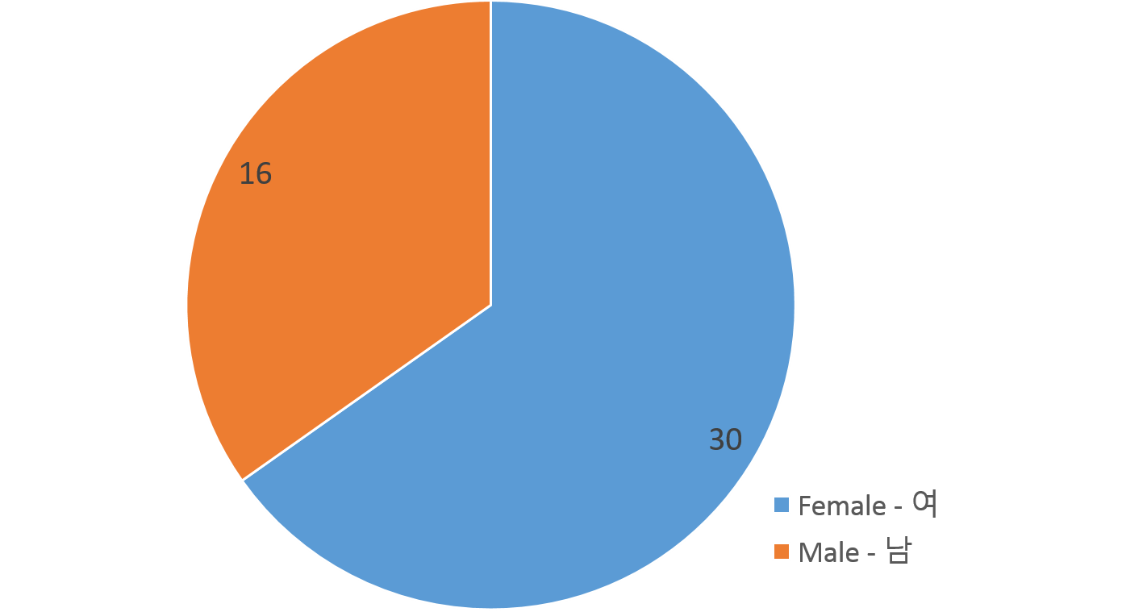
Gender

Slide 38
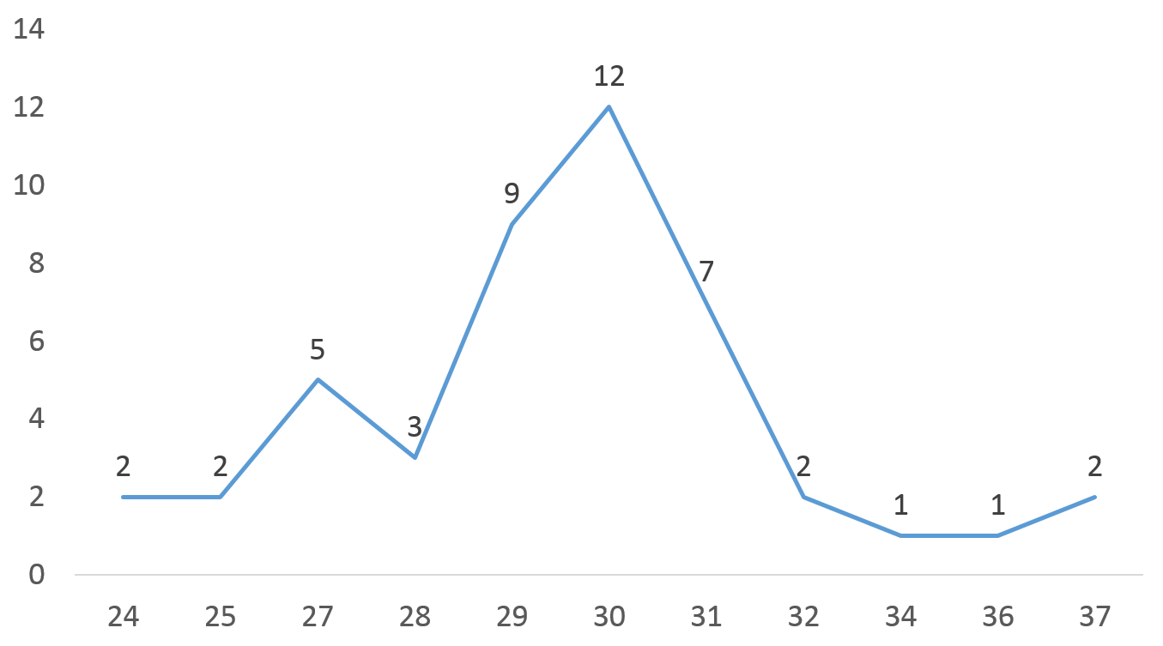
Self-Efficacy

Slide 39
Prep - Use of media for class preparation

Slide 40
Prep - Use of media for class preparation

